Slide 1
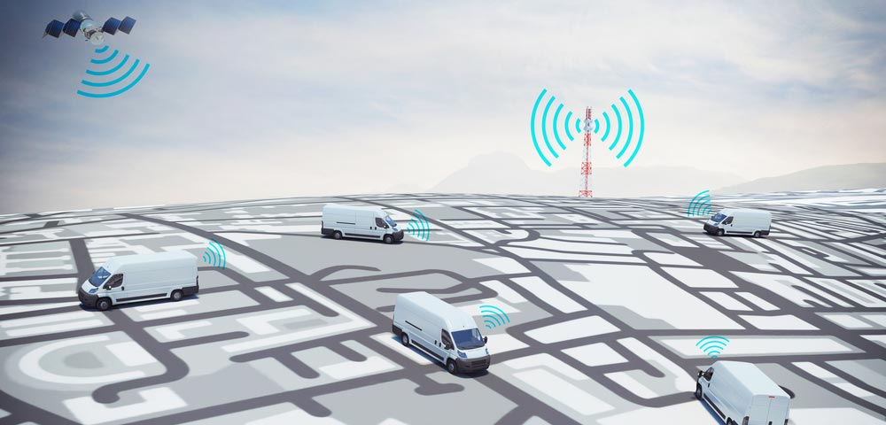
Route Trax – Fleet Route Trax – Web reports (TMC)
Sit Dolor Amet

Slide 2
Route Trax - Fleet
Fleet Management for your carriers
Incorporating a real-time 4G LTE IoT (Internet of Things) personal GPS asset tracking device
Synced with an online portal where managers can view each carrier’s breadcrumb trail
Date & time of breadcrumb and driving speed of the carrier
Web Based GPS Portal
Can watch carrier in real-time
Multiple routes for carriers
Works in conjunction and syncs with our Route Trax - TMC and Route Trax - Home Delivery products
Verifies deliveries with a timestamp down to the minute that the delivery was made.
Carriers can maintain their privacy in off hours with the built-in on/off switch.
Route Trax – Fleet GPS Device

Slide 3
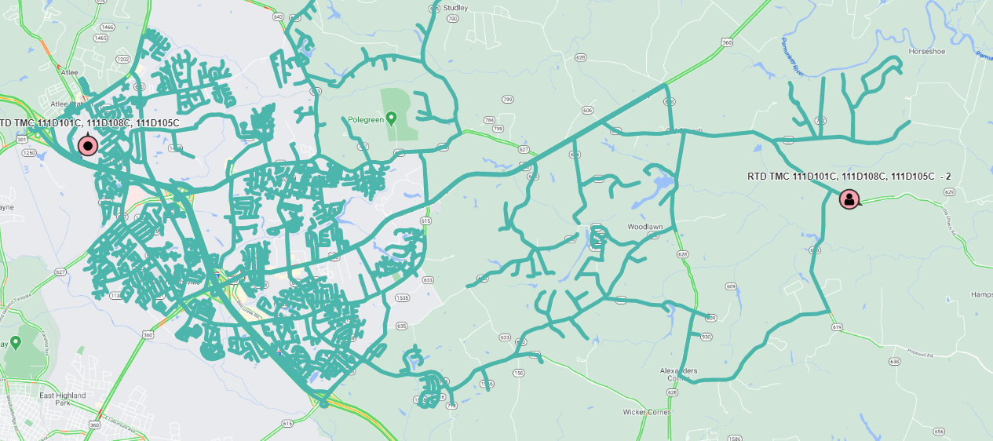
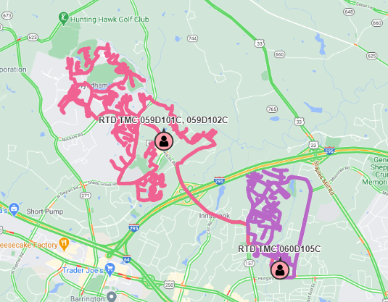
Example Routes with gps trails
Samples taken from the Route Trax - Fleet web portal.
Large Route GPS Trail
Multiple Route GPS Trail

Slide 4
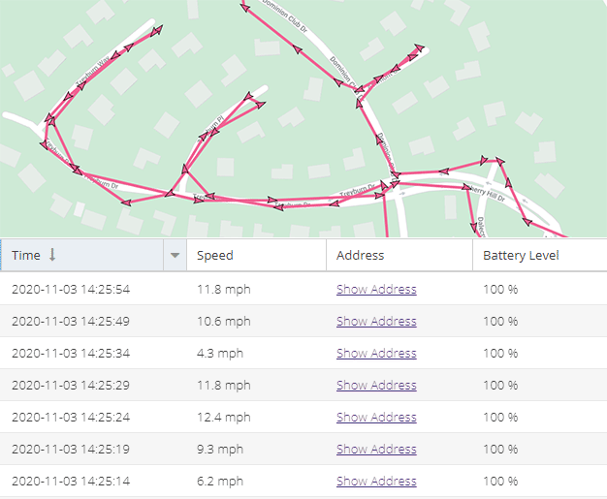
Breadcrumbs
Interactive arrows spread across the GPS trail. Each arrow represents the location of a carrier at a specific time. Managers can click on each arrow in the Route Trax – Fleet web portal to view location information.
Captured every 5 seconds:
Date & Time
Current speed
Address on demand

Slide 5
Route Trax – Web Reports (TMC)
Web based reporting portal
Calendar display of verified deliveries
Calendar display of non-verified deliveries
Non-verified Google Maps with GPS Trail
Available reports
Delivery Times by Carrier
Routes Delivered by District
Verified by Carrier
No Delivery by Carrier
Verified Rollup by District

Slide 6
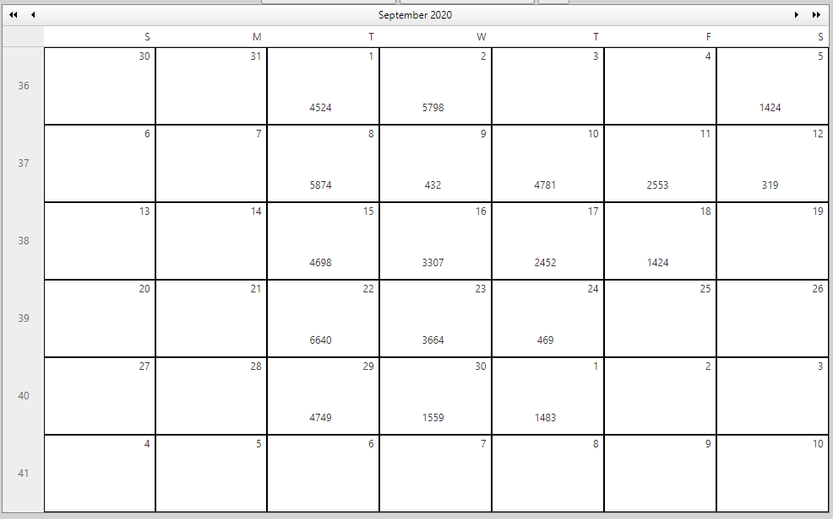
Verified deliveries by delivery day

Slide 7
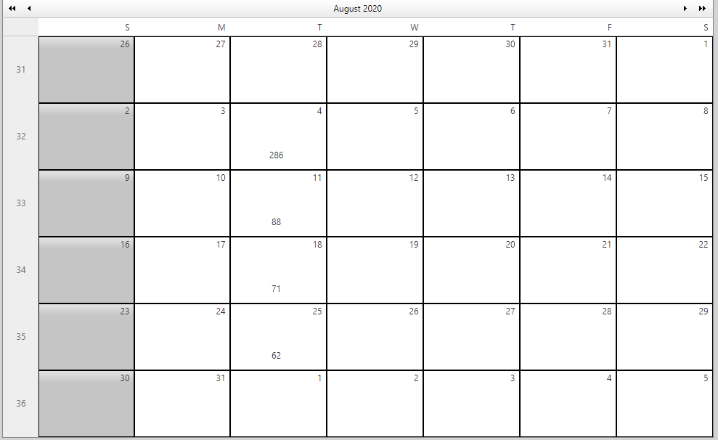
Non-Verified deliveries by CARRIER

Slide 8
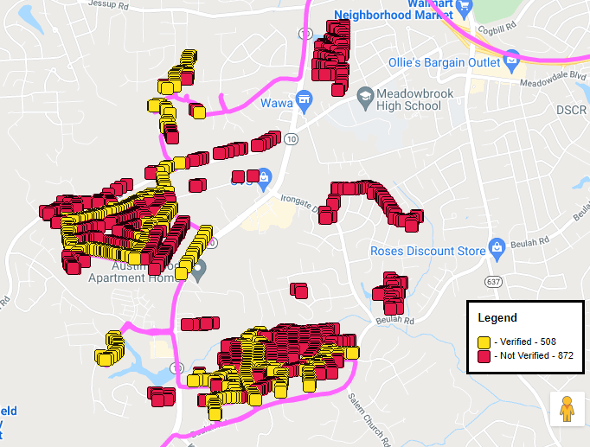
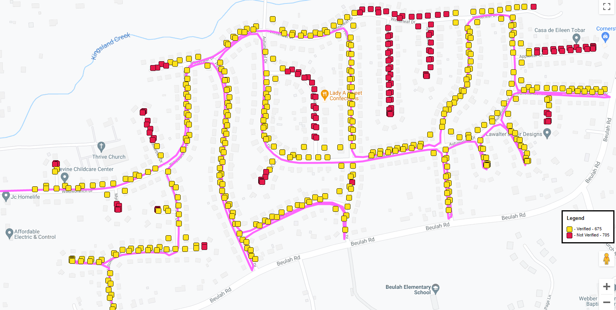
map with GPS Trail showing Non-Verified locations
Full Route View with GPS Trail
Drill Down Route View with GPS Trail

Slide 9
Routes delivered by district Report

Slide 10
Verified by carrier Report

Slide 11
No delivery by carrier report

Slide 12
Verified rollup by district report

Slide 13
Route Trax - Fleet
James Vaught
President & CTO
jvaught@envisiondelivery.com
http://envisiondelivery.com
(214) 493-3418
Providing Last Mile
Delivery Verification and Route Optimization
for TMC, Home Delivery and Single Copy

